Slide 1
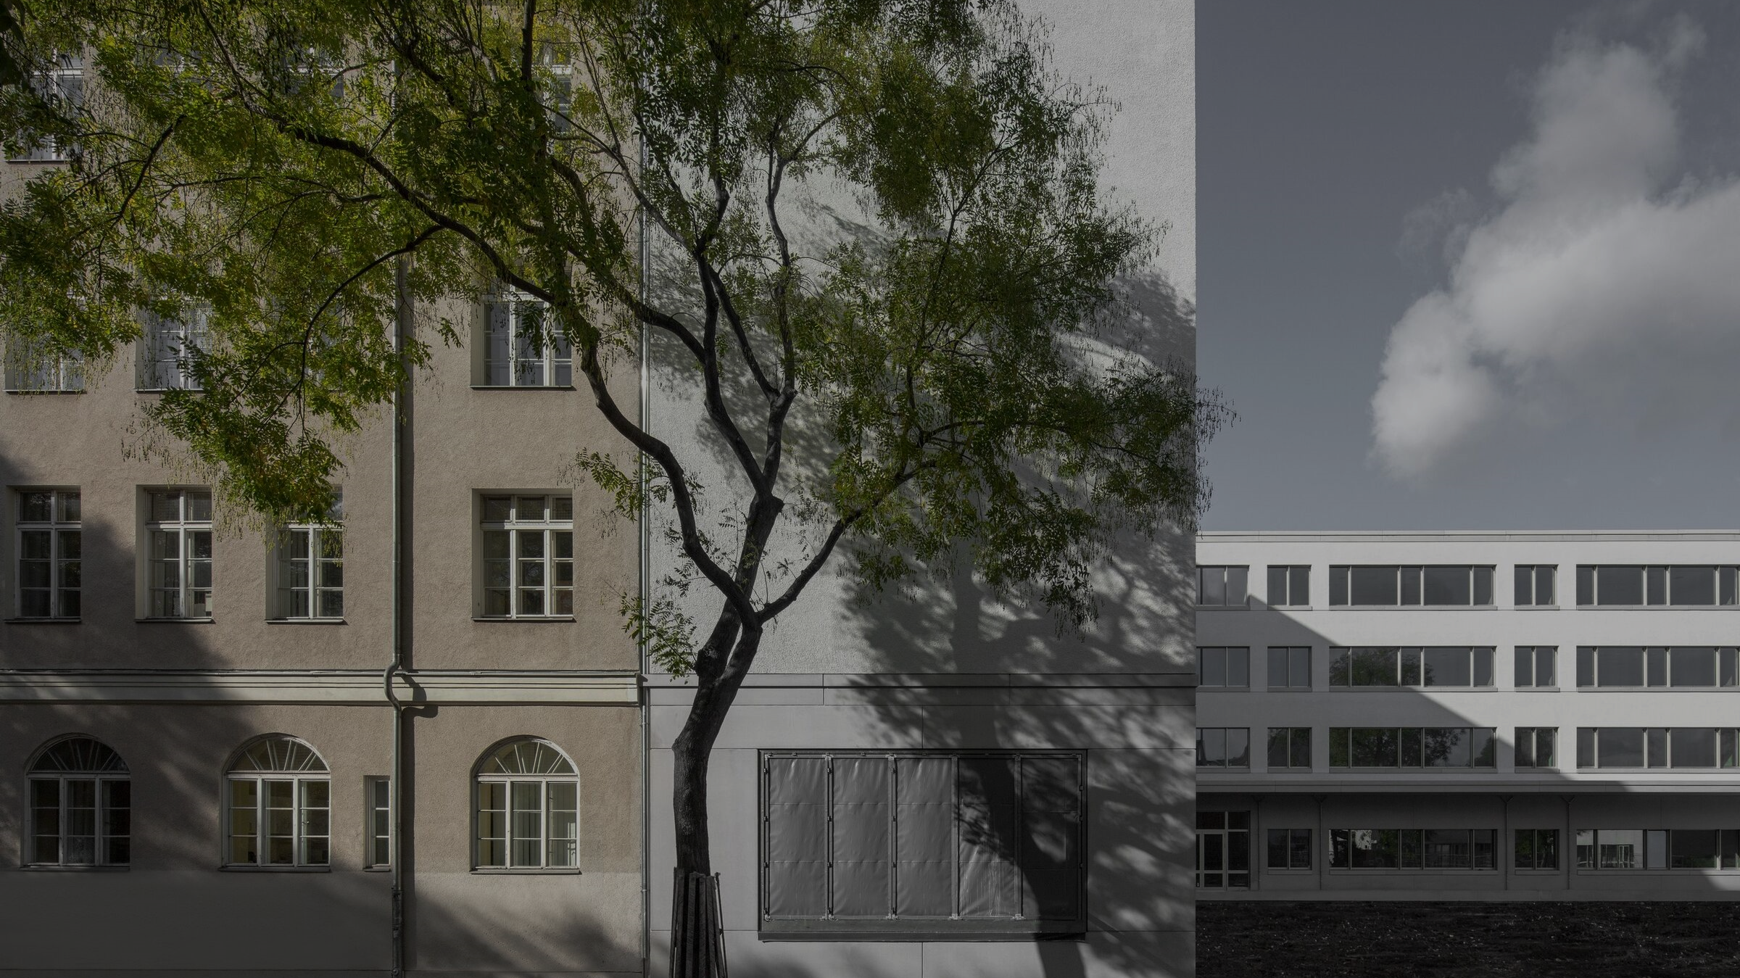
Community school for underprivileged children Rutli Campus Gaziza Gaukhar Diana

Slide 2


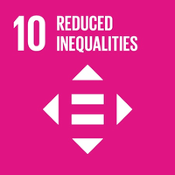

Sustainable Development Goals

Slide 3


Background Information
45%
New Educational system demand

Slide 4
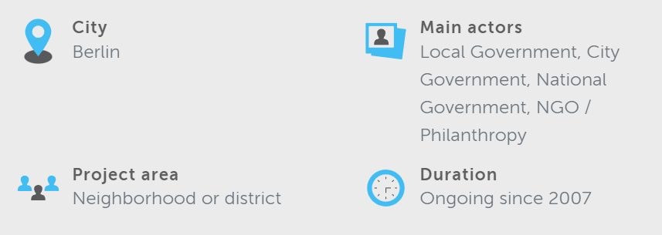

Slide 5
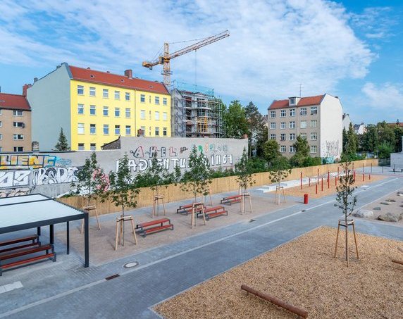
Outcomes and impacts

Slide 6
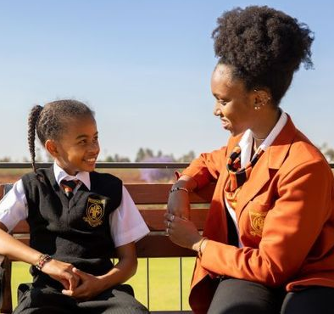



Lessons Learned
Stakeholder Commitment
Public Engagement and Media Outreach
Integration of Children and Parents
Innovative Solutions Implementation

Slide 7
Recommendations
Comprehensive support services
Individual educational approaches

Slide 8
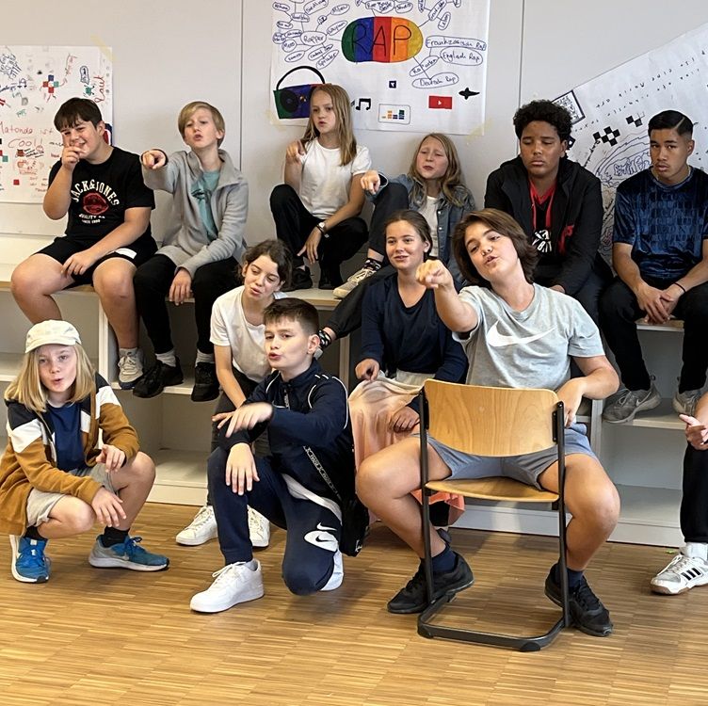
Conclusion

Slide 9
Q&A Session

Slide 10
Acknowledgments
The mayor of Neukölln, Heinz Buschkowsky.
Christina Rau.
Stiftung Zukunft Berlin.
Freudenberg Foundation.

Slide 11
Applicability
socio-economic development
Socio-economic development
Affordable education

Slide 12
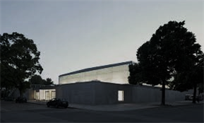
References
https://www.welt.de/politik/deutschland/article129779285/Wie-die-Ruetli-Schule-doch-noch-erfolgreich-wurde.html
https://www.coe.int/en/web/interculturalcities/-/campus-rutli

